Slide 1
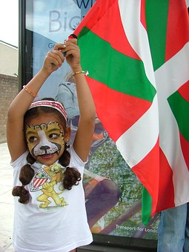
FANDOM: A subculture of varied communities
Mary katherine canupp
South Piedmont Community college
Figure 1. Young Fan(pixabay.com)

Slide 2
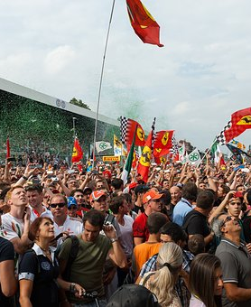
Introduction
Within the United States lies a subculture that is vibrant, progressive and thriving. It fills America's leisure time and filters into everyday life. Every age, gender and race is represented and all areas of the nation are involved.
This subculture can be observed through it's symbols, heard through it's language and witnessed through it's norms, beliefs, and values. Fandom's material culture helps fuel America's economy.
Welcome to the subculture of Fandom.
Figure 2. Loyal Fans (pixabay.com)

Slide 3
Subculture defined
What is a subculture?
Merriam-Webster defines Subculture as, "an ethnic, regional, economic, or social group exhibiting characteristic patterns of behavior sufficient to distinguish it from others within an embracing culture or society."
In other words, it is a group that differs in it's values, norms, and beliefs from the larger society that it is part of.

Slide 4
Fandom defined
Fandom is a subculture made up of many different communities that share an enjoyment of something in popular culture, The commonality may be a book, movie, tv show, music group, art form, sports team or other aspect of their culture.
Fandom's are participatory cultures which include consumers, producers, and creators. ("Fandom and Participatory Culture," n.d. para., 1)

Slide 5
Fandom communities – Who they are
There are many different communities within the Fandom subculture. The lists in Table 1 are just a sampling of the many varied communities within the larger subculture.
Each community has it's own language, symbols, norms and values. They are, in effect, a subculture within a subculture.

Slide 6
Fandom communities - Who they are (Part 2)
Table 1. Fandom Communities
Sports | Music | Sci-fi/Literary | Television/Movie | Other
Cheese Heads | Beliebers | Trekkies | Whovians | Furries
Terps | Parrotheads | Tolkenians | Bronies | Otherkins
Hoosiers | Dead Heads | Potter Heads | Roswellians | Otakus
Tarheels | Swifties | Sherlockians | Fireflies

Slide 7
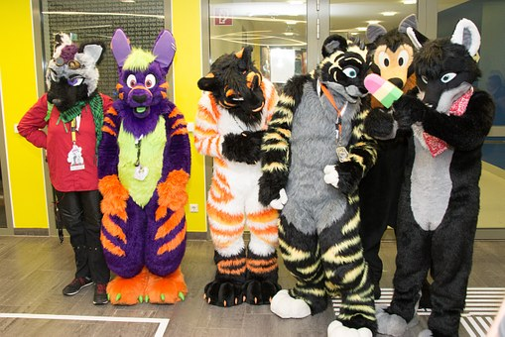
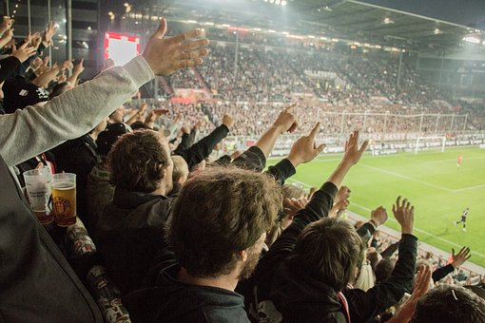
Fandoms – what they do
Members of the Fandom subculture are very involved in their communities. Regardless of the community, they all thrive on being together in and being a part of something bigger. Community members:
Attend conventions / games / events
Create fanzines
Cosplay- dress up
Attend screenings
Interact on blog sites
Figure 4. Furries (pixabay.com)
Figure 3. Soccer Fans (pixabay.com)

Slide 8
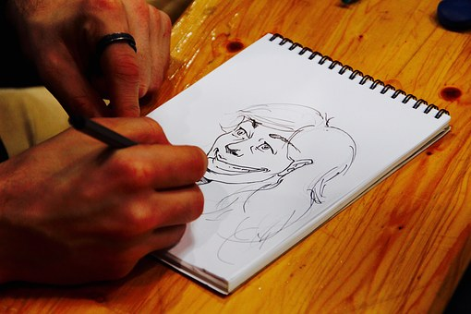
Fandoms – what they do (part 2)
Create fan websites
Create art work
Create extensions of original literary works
Perform charity work
Pursue knowledge of their fandom
Figure 5. Sketch Art (pixabay.com)

Slide 9
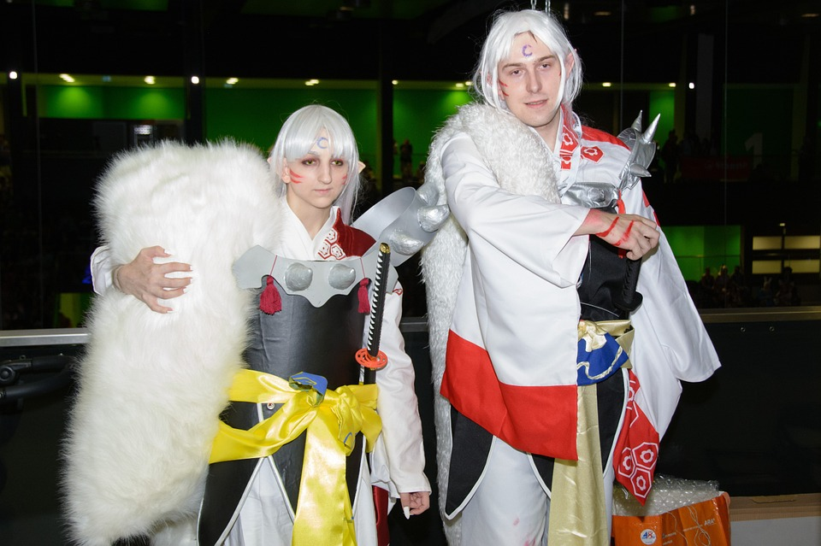
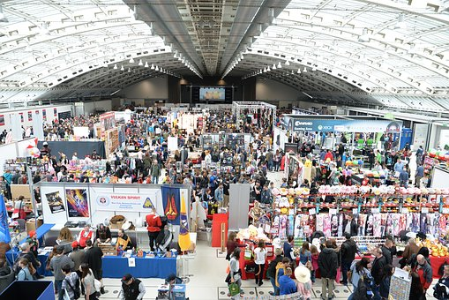
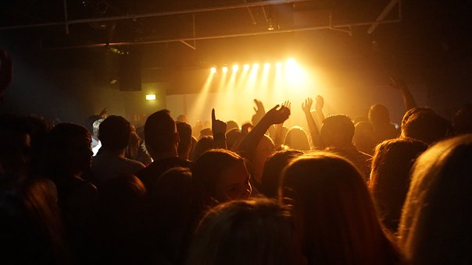
Figure 7. Cosplay (pixabay.com)
Figure 8. Concert (pixabay.com)
Figure 9. Comiccon (pixabay.com)

Slide 10
Fandom – cultural symbols
A cultural symbol is anything that is recognized by a culture that holds special meaning or represents something within the culture.(Maciones, 2015)
In the Fandom subculture, symbols abound. Symbols represent sports teams and good versus evil. They represent characters, feelings, and hierarchy within a community.
Symbols are found in books, on websites, on clothing and in jewelry. They serve to aid in immediately identifying other members of the community.

Slide 11

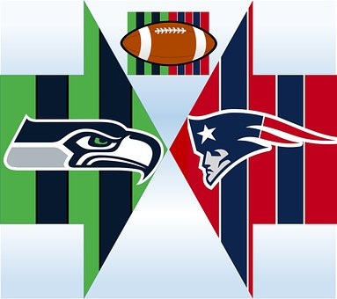


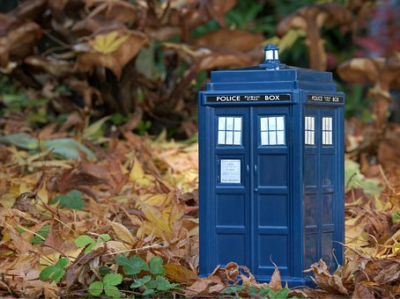
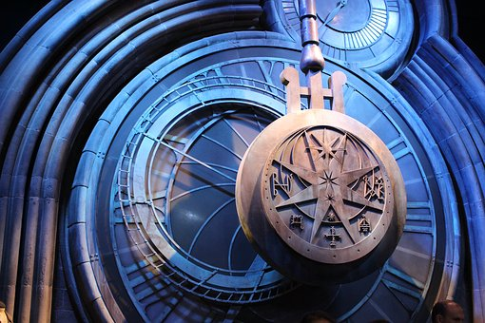

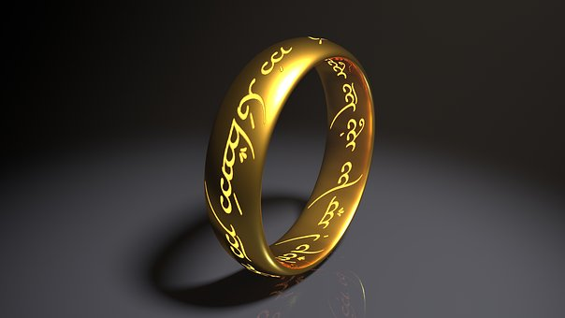

Figure 10.Black Knights (wikimedia)
Figure 18. Football (pixabay.com
Figure 12. Captain America (pixabay.com)
Fig. 16. Otaku (wikimedia)
Figure 15. Lord of the Rings (pixabay.com)
Figure 11. Harry Potter
(pixabay.com)
Figure 17. Star Trek (wikimedia)
Figure 19. Tardis(pixabay.com)
Figure 13. Footlball Club (pixabay.com)

Slide 12
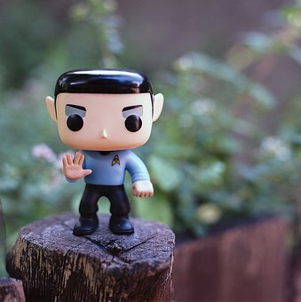
Fandom – their own unique language
A cultural language enables members of a culture to communicate. This communication takes place both verbally and in the written form. It can also include body language.
Along with the basic verbal language of the Fandom subculture, some communities have developed their own formal language and body language such as, the Star Trek alien languages of Vulcan and Romulen.
Figure 20. Vulcan Language (pixabay.com)

Slide 13
Fandom Language
AU – Alternate Universe
Crack-stories in which the unbelievable occur
Feels- short for feelings
Mash-up- a video of tv or movie clips set to a song
Shipping – in a relationship
Baseball Fandom Language
Ace- team's best starting pitcher
Bag- a base
Around the horn-a type of double play
Bandbox- a small ballpark good for hitters
Bronx Cheer- when the crowd boos
Football Fandom Language
"Blitz- When linebackers or defensive backs unexpectedly dart in to attack the quarterback"
"Bootleg- When a quarterback fakes a handoff to a running back and takes it outside either to pass it or run it himself".
Pick- Interception

Slide 14

Fandom – cultural norms
Cultural Norms are rules either written or unwritten that guide a society in what is right or wrong. It is the behavior that is expected and customary.(Maciones, 2015)
In Fandoms, the accepted norms are sometimes much different than the culture that surrounds them. Sometimes even what a culture deems illegal behavior is accepted as the norm.
Figure 21. Rules (pixabay.com)

Slide 15
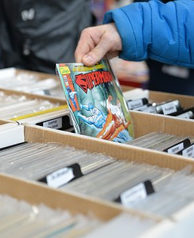
Fandom – cultural norms (part 2)
At ballgames and concerts it is customary to be loud. Rude behavior is also acceptable such as booing and wanting players to do poorly. This is in contrast to the American culture of helping to lift others up.
Some Otaku members are known to participate in the black market for sales and recordings of movies and music. These pirated items are sold and distributed illegally.(Eng,2005)
Figure 22 Comic Books (pixabay.com)

Slide 16
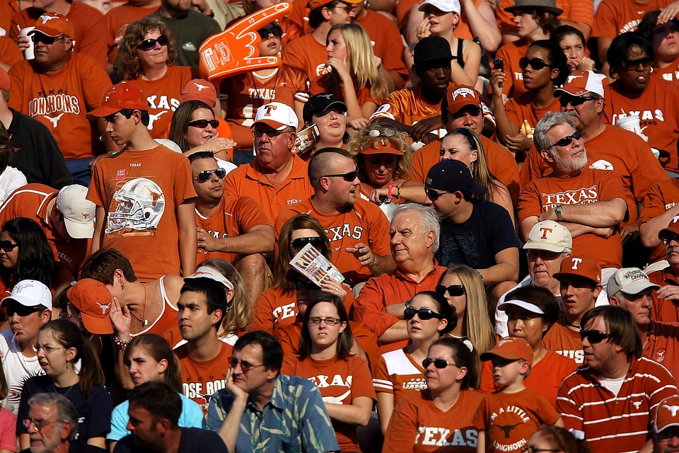
Fandom – cultural norms (part 3)
It is customary for members of some communities to dress in costumes and role play in an imaginary world as adults.
It is also customary for fans of teams to wear the same colors when attending games and events. The general American culture does not typically dress the same.
Figure 23. Sports Fans (pixabay.com)

Slide 17
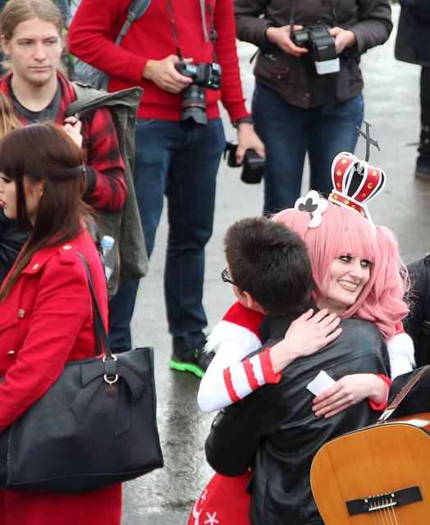
Fandom – cultural values
Cultural Values help a society determine what is desirable. It helps them determine whether something is good or bad, pleasurable or not.
Members of Fandom communities share a strong desire to be a part of an inclusive group. They enjoy sharing their passion with other like-minded people.(Brooker,2005)
They long for the bond that joins them with others who enjoy the same past times and interests.
Figure 24. Fan Hugs (pixabay.com)

Slide 18
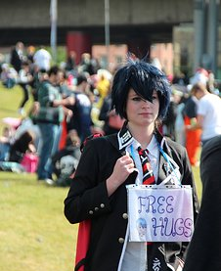
Fandom – cultural values (part 2)
Fandom members value the freedom to create their own reality. They are motivated by self-invention and the ability to create their own cultures and in so doing they are able to express their social visions and fantasies. (Harris, 1998)
Figure 25. Social Hugs (pixabay.com)

Slide 19
Fandom - Cultural Values (Part 3)
In his research on Star Trek fans, Jindra sums up the values of the Fandom subculture:
"Recently, academics have begun to turn their attention to the hard-to-ignore fans themselves. Most recent work published on fandom has come out of a cultural studies framework, which focuses on how active fans use the show for their own purposes. Fans are "textual poachers" (Jenkins 1992; Bacon-Smith 1992), who take the ST universe and create works (stories, art, music, games) that allow them to deal with social issues (e.g., feminism) in the process creating alternative communities." (Jindra, 1994)

Slide 20
Fandom – cultural beliefs
Cultural beliefs are "specific ideas that people hold to be true.' (Maciones, 2015)
In the Fandom culture, members believe that the outcome of their involvement is not as important as the actual involvement itself. They crave, "recognized membership and interaction centering around a common object." (Harris, 1998)

Slide 21

Fandom – cultural beliefs (Part 2)
Many Fandom communities are involved in helping with charities. The Star Wars 501st Legion is dedicated to helping many organizations through their free appearances as Star Wars villains. They only request that a donation be made to a charitable organization on their behalf.
One Fandom website, www.fandomgiveback, is dedicated to giving back to their communities by bringing members of different fandoms together in a safe, non-threatening environment to help others.
Figure 26. Charity Work (Pixabay.com)

Slide 22
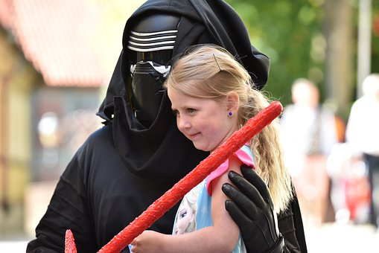
Fandom – cultural beliefs (Part 3)
Many Fandom communities are involved in helping with charities. The Star Wars 501st Legion is dedicated to helping many organizations through their free appearances as Star Wars villains. They only request that a donation be made to a charitable organization on their behalf.
Members reported combined contributions at $889,000 in 2016. (Fundraising, 2017)
Figure 27. Charity Work (pixabay.com)

Slide 23
Fandom – material culture
Material Culture is described as items that help to define a culture and can include items such as buildings, clothing, books, DVD's, and much more. They are the physical items that make a culture what it is.
Fandom material culture includes (Jindra,1994):
Novels Fanzines Art Work Jewelry
DVD's Plush Toys Costumes Flags
Games Clothing Dictionaries Bags

Slide 24
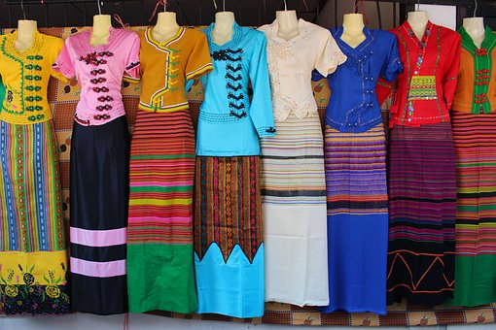
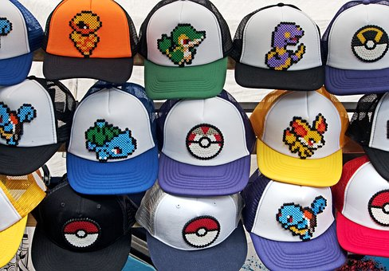
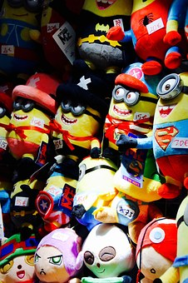
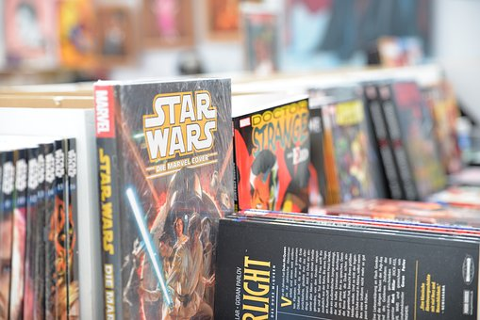
Fandom – material culture (part 2)
Figure 30. Ball Caps(pixabay.com)
Figure 28. Original Costumes (pixabay.com)
Figure 29. Plush Toys (pixabay.com)
Figure 31. Books (pixabay.com)

Slide 25
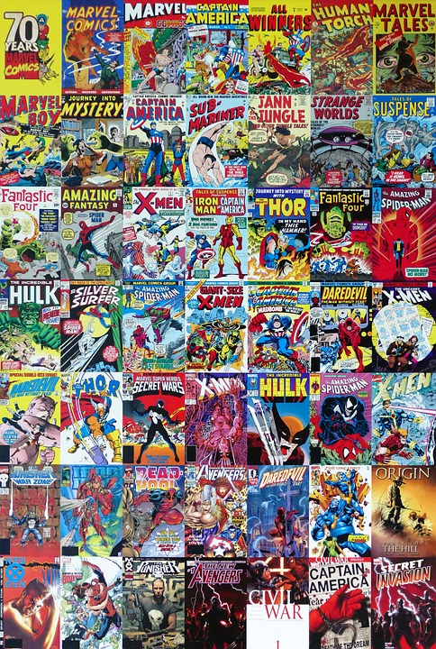
Fandom – material culture (part 3)
"Active acquisitive material culture in which the collection of objects central to the practice of fandom serves both as an admission to fandom and as a form of ritualized maintenance." (Harris, 1998)
Figure 32. Marvel Comics (pixabay.com)

Slide 26
Works Cited
Brooker, W. (2005). "It is love": The Lewis Carroll Society as a fan community. The American Behavioral Scientist, 48(7), 859 880 Retrieved from http://proxy004.nclive.org/login? URL= http://search.proquest.com/docview/214764421?accountid=13993
Eng, L. (2005). Otaku. In S. R. Steinberg, P. Parmar, & B. Richard (Eds.), Contemporary youth culture: an international encyclopedia. Westport, CT:Greenwood. Retrieved from http://proxy004.nclive.org/login? URL= http://search.credoreference.com/content/entry/gwyouth/otaku/0? institutionId=3688
Fandom, Cult Media, and Subculture Studies (Minor) https://communication.depaul.edu/academics/minors-concentrations/Pages/fandom-minor.aspx
Fandom and Participatory Culture. (n.d.). Retrieved from http://haenfler.sites.grinnell.edu/fandom-and-participatory-culture/#ffs-tabbed-11
Harris, Cheryl, and Alison Alexander. 1998. Theorizing Fandom: Fans, Subculture, and Identity. Cresskill, N.J.: Hampton Press.
Jindra, M. (1994). Star Trek fandom as a religious phenomenon. Sociology of Religion, 55(1), 27. Retrieved from http://proxy004.nclive.org/login? URL= http://search.proquest.com/docview/216768653?accountid=13993
Merriam-Webster Dictionary. https://www.merriamwebster.com/dictionary/subculture
The Art of Fandom. https://infogr.am/the-at-of-fandom
Maciones, J (2015). Society the Basics. (13th ed.). Boston:Pearson
Fundraising:Donationsmade in honor of 501st Legion (2017). Retrieved from: https://www.501st.com/charity
FandomGiveBack.com (2013). Retrieved from: Fandomgiveback.com/about-the-project/

Slide 27
Works Cited
Figure 1 https://pixabay.com/en/child-girl-flag-footbal-fan-1509603/
Figure 2 https://pixabay.com/en/photos/?image_type=&cat=&min_width=&min_height=&q=sports+fans&order=popular
Figure 3 https://pixabay.com/en/football-football-match-flags-rush-1908717/
Figure 4 https://pixabay.com/en/cosplay-panel-anime-manga-dress-up-980213/
Figure 5 https://pixabay.com/en/comiccon-dortmund-fair-comic-1143665/
Figure 7 https://pixabay.com/en/cosplay-pannel-anime-manga-dress-up-980225/
Figure 8 https://pixabay.com/en/photos/?imagetype=&cat=&minwidth=&min_height=&q=concert+hands&order=popular
Figure 9 https://pixabay.com/en/comic-con-convention-centre-people-2228405/
Figure 10 https://commons.wikimedia.org/wiki/File:USMA-BlackKnights-Logo.svg
Figure 11 https://pixabay.com/en/harry-potter-clock-harry-potter-2206195/
Figure 12 https://pixabay.com/en/captain-america-comic-book-1293949/
Figure 13 https://pixabay.com/en/sheilds-raccoons-football-1785039/
Figure 14 https://pixabay.com/en/rules-hand-leave-marker-pen-wont-1752405/
Figure 15 https://pixabay.com/en/ring-lord-who-rings-hobbit-1671094/
Figure 16 https://commons.wikimedia.org/wiki/File:Symbol_Bratislavskych_otaku.jpg
Figure 17 https://commons.wikimedia.org/wiki/File:Star_Trek_Barnstar_03_Hires.svg
Figure 18 https://pixabay.com/en/football-american-super-bowl-sport-606358/
Figure 19 https://pixabay.com/en/tardis-dr-who-doctor-who-1816598/
Figure 20 https://pixabay.com/en/spock-star-trek-vulcan-1541528/
Figure 22 https://pixabay.com/en/comic-con-convention-comic-books-2214290/
Figure 23 https://pixabay.com/en/spectators-sports-fans-football-fans-1573901/
Figure 24 https://pixabay.com/en/hug-quantitative-love-cosplay-1546444/
Figure 25 https://pixabay.com/en/free-hugs-japantag-düsseldorf-1546365/
Figure 26 https://pixabay.com/en/volunteer-charity-cloud-community-1326758/
Figure 27 https://pixabay.com/en/joy-smile-children-kylo-pure-1662082
Figure 28 https://pixabay.com/en/dresses-thai-style-thai-style-2059493/
Figure 29 https://pixabay.com/en/minions-comiccon-dortmund-fair-1143667/
Figure 30 https://pixabay.com/en/pokemon-hat-go-pokemon-go-baseball-1611095/
Figure 31 https://pixabay.com/en/comic-con-comics-books-star-wars-2216147/
Figure 32 https://pixabay.com/en/marvel-comics-cartoon-entertainment-1641554/

